Slide 1
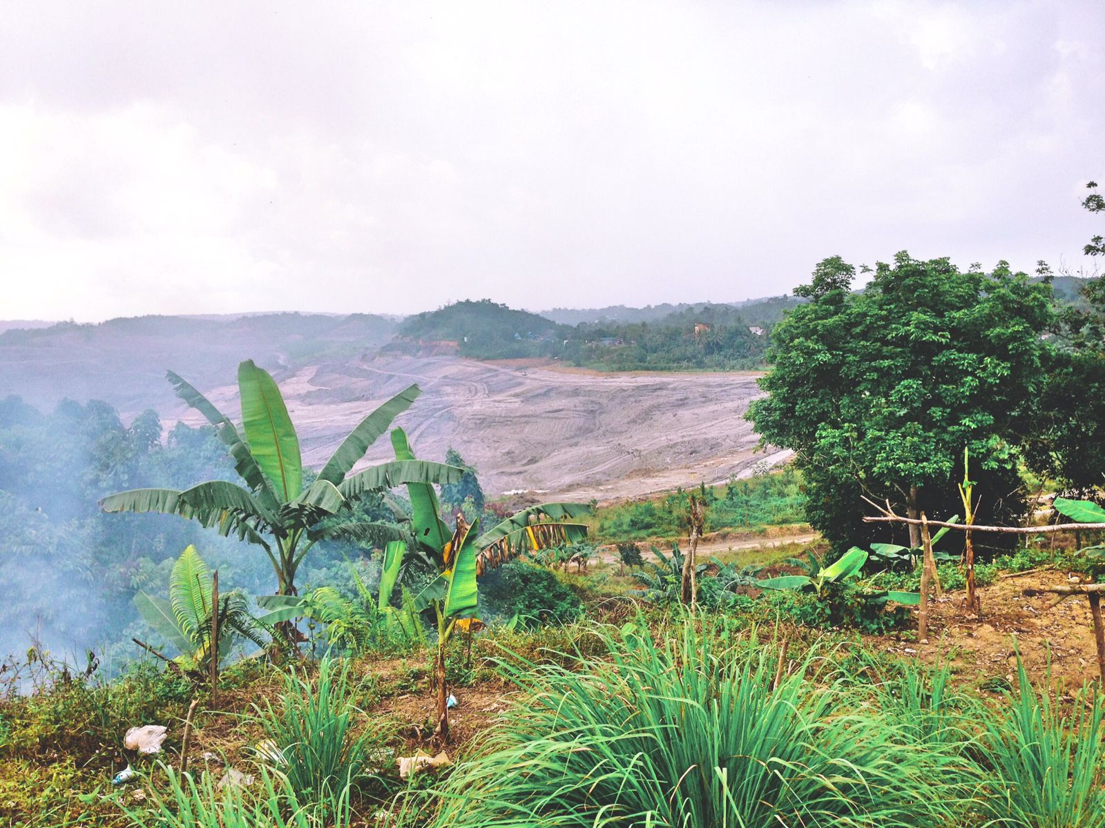
COAL MINING CONFLICT SETTLEMENT:
between legal certainty and protection
of the environment and society
Mohamad Nasir
(Faculty of Law, Universitas Balikpapan East Kalimantan, Indonesia)
Muhamad Muhdar
(Faculty of Law, Universitas Mulawarman, East Kalimantan, Indonesia

Slide 2
Background

Slide 3
Background (#1)
East Kalimantan Province Spatial Plan (2015-2035) provides space for the cultivation area of 10,451,331
Land Use in the Cultivation Area | Allocation (hectares)
Production forest | 6.055.793
Coal Mining | 5.227.136
Agriculture and plantation | 3.681.657
Tourism | 396.266
Fishery | 187.304
Settlement | 97.442
Industry | 57.176
Total | 15.702.774

Slide 4
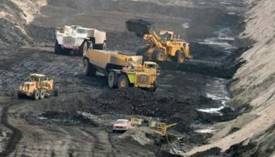
Background (#2)
01
Overlapping land use
02
Conflicts
03
Settlements
Coal mining carried out in cultivation areas such as settlements, plantations, agriculture and forestry
Land Claims: Coal mining company vs community
Land-use: Coal mining company vs other land-based activities
Environmental degradation
Non-litigation
Litigation

Slide 5
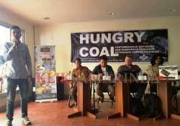
Aims
Examines he legal framework of conflict resolution in addressing disputes arising from land claims and environmental degradation
1
Investigates how it is implemented on the ground to get an insight into how effective these dispute resolution options are in resolving conflicts
2

Slide 6
Legal Framework

Slide 7
Legal Framework: Coal mining & Land Laws
Allow overlapping of land. Mining can be carried out in cultivation areas such as settlements, plantations, agriculture and forestry
Land rights vs land-use
Land- use vs land-use
The mining legislation provides conflict settlement rules, which presuppose the agreement of all the parties, but do not regulate when the parties do not reach an agreement.
1
3
GR Nr. 43 of 2021: the overlapped part should be excluded from that mining concession area
GR Nr. 96 of 2021: the central government undertakes to resolve the dispute through mediation if the parties do not reach a consensus
When there is overlapping land, the priority is mining.
(i.e. Presidential Instruction Number 1 of 1976)
4
2

Slide 8
Legal Framework: Environmental law
Environmental Dispute
Non-litigation
Negotiation
Mediation
Litigation
Private (citizen, NGO & Gov)
Administrative
Criminal (Envi. crime)

Slide 9
Conflict Settlement

Slide 10
Conflict settlement: land claim
(community vs coal mining company)
1
Negotiation
2
Complaint to Government
Protest/Demonstration
4
Lawsuit
(private, administrative, criminal)
3
Mediation
5

Slide 11
Conflict settlement: land-use
(oil palm plantation company vs coal mining company
or among coal mining companies)
1
2
3
NEGOTIATION
MEDIATION
ADMINISTRATIVE COURT
Cancellation of mining company license
Coal mining company vs oil palm plantation company – join land-use agreement (JLUA)

Slide 12
Conflict settlement: Environmental dispute
1
Negotiation
2
Mediation
Protest/Demonstration
4
Lawsuit
(private, administrative, criminal)
3
Administrative claim
5

Slide 13
Remarks
The mining regulations provide the possibility to mine in zones designated for other uses can cause an overlap among land-based sectors.
It can lead to land claim and land-use conflicts
Mining and land regulations do not provide rules on settling the dispute if no agreement is reached until the government promulgated GR Nr. 43 of 2021 & GR Nr. 96 of 2021
Even is a settlement is reached, coal mining activities exploit natural resources below the earth's surface and change an area's landscape dramatically. Coal mining thus generates considerable environmental damage to other land-based sectors.
It can create environmental dispute
Non-litigation approaches in the environmental dispute often places the community in an unequal position.
Communities around mining sites rarely apply lawsuits to ask for compensation or recovery action from mining companies.
In addition, using criminal environmental instruments takes time and requires financial support in the evidentiary process.

