Slide 1
CNS INFECTION
Annisa Muhyi, dr, Sp.A, M.Biomed
SMF Ilmu Kesehatan Anak RSUD AWS
Fakultas Kedokteran Universitas Mulawarman
Samarinda

Slide 2
Introduction
Brain is normally a sterile. Protected by skull and the blood–brain barrier
Rare, medical emergencies, can lead to death or severe neurologic sequelae
Etiology : viral, bacterial, parasitic, autoimmune
Swaiman’s pediatric neurology principles and practice 2017
Pratibha Singhi, Central nervous system infections in childhood 2014

Slide 3
Epidemiology
Acute encephalitis (viral infection) : 10.5-13.8 per 100.000
Pneumococcal meningitis on child < 5 years old (bacterial infection) : 17 per 100.000
Risk of major sequelae on southeast Asia (bacterial infection) : 21.6 %
Developing world has 1.3 million cases of TB & 40,000 TB-related deaths annually among children
Tuberculous meningitis complicates approximately 1 of every 300 untreated primary TB infections
Swaiman’s pediatric neurology principles and practice 2017
Pratibha Singhi, Central nervous system infections in childhood 2014

Slide 4
Principles Management of CNS Infection

Slide 5
Principles Management
Most of CNS infection have similar clinical presentations and complications
Reduction in mortality and long-term morbidity is critically. It depends on:
Rapid diagnosis
Prompt initiation of appropriate antimicrobials, supportive and adjunctive therapy.
Management of complications,
Early (e.g. raised intracranial pressure, seizures and status epilepticus)
Late (e.g. hydrocephalus, focal neurological deficits, psychomotor delay and sensorineural hearing loss).

Slide 6
Emergency Management
Clinical signs that suggest need for admission to the PICU
Glasgow Coma Scale score ≤ 8 Airway instability Poor/irregular respiratory effort Respiratory distress Hyperventilation Poor perfusion/hypotension Oliguria/anuria Hypertension/bradycardia | Abnormal posturing Impaired papillary response Abnormal doll-eye response Abnormal motor response Focal neurodeficits Cranial nerve palsy Seizures Bleeding diathesis
Pratibha Singhi, Central nervous system infections in childhood 2014

Slide 7
Seizure and status epilepticus

Slide 8
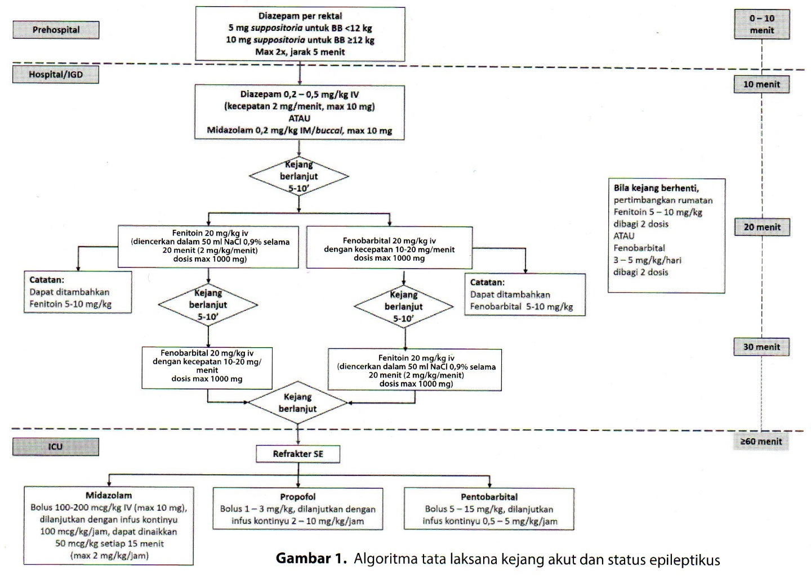

Slide 9
increased Intracranial pressure

Slide 10
Management Increased ICP
Intracranial pressure monitoring
General measures
Positioning
Fever
Anemia
Prevent of seizure
Hyperosmolar therapy
Mannitol
Hypertonic saline

Slide 11
Mannitol
Dose 0.25 – 1 g/kg/x iv bolus
Repeated every 6-8 hour
Side effect : hyperosmolarity, hypovolemia, electrolyte disturbance Campur dengan NaCl 0.9% (1:1)
Hypertonic saline
Use NaCl 3% as hypertonic saline
Dose initial 2-6 mL/kg iv bolus
Continued with NaCl 3% infusion rate 0.1 – 1 mL/kg/hour
Pratibha Singhi, Central nervous system infections in childhood 2014

Slide 12
Viral encephalitis

Slide 13
Pathogenesis
Plasma Viremia
Hematogen – neuronal spread
Encephalitis
Plasma Viremia
Infect leukocytes
Activated cells cross BBB
encephalitis
Diane EG, Pathogenesis of central nervous system infections. In : Pratibha S, Diane EG,Charles EN, editor. Central nervous system Infections in childhood. Mac Keith Press, London. 2014

Slide 14
Clinical manifestation
Neonates and young infants — fever, seizure, poor feeding, irritability, lethargy, or decreased perfusion
Children and adolescents — fever, psychiatric symptoms, emotional lability, movement disorder, ataxia, seizures, stupor, lethargy, coma, or localized neurologic changes (eg, hemiparesis, cranial nerve defect, ataxia).
Kimberlin DW, Lin CY, Jacobs RF, et al. Natural history of neonatal herpes simplex virus infections in the acyclovir era. Pediatrics 2001; 108:223.

Slide 15
Clinical manifestation
Manifestation of encephalitis on prospective series:
100%
depressed consciousness
80%
Fever
78%
Neurologic deficit signs
56%
Seizure
Kolski H, Ford-Jones EL, Richardson S, et al. Etiology of acute childhood encephalitis at The Hospital for Sick Children, Toronto, 1994-1995. Clin Infect Dis 1998; 26:398.

Slide 16
Clinical manifestation
Focal seizure or focal neurologic signs :
Encephalitis with psychiatric symptoms :
suspect HSV encephalitis
suspect autoimmune encephalitis
(Anti-N-methyl-D-aspartate receptor encephalitis)

Slide 17
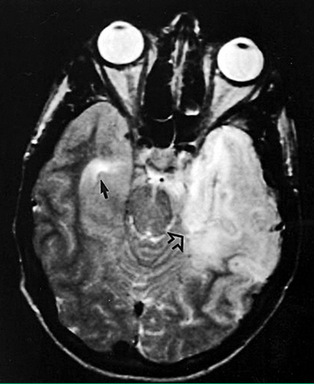
Diagnostic evaluation
Lumbal puncture to rule out differential diagnosis
CSF pleocytosis (60 %)
Red blood cells presence can indicate HSV encephalitis
Protein is slightly elevated
Glucose is normal
Imaging study (preferably MRI) : brain edema & rule out differential diagnosis
EEG to find focal seizure (temporal seizure indicate HSV encephalitis)
James FB. Viral infection of the nervous system. In : Kenneth FS, Stephen A, Donna MF, Nina FS, editor. Swaiman’s pediatric neurology principles and practice. Elsevier. 2014.

Slide 18
Treatment
Encephalitis is self limiting disease
Empiric antimicrobial therapy for prevention and supportive care
Treat seizures as soon as possible
Treat increased intracranial pressure
Children with severe encephalitis should be hospitalized in ICU
American Academy of Pediatrics. Herpes simplex. In: Red Book: 2012 Report of the Committee on Infectious Diseases, 29th, Pickering LK. (Ed), American Academy of Pediatrics, Elk Grove Village, IL 2012. p.398.

Slide 19
Treatment
Acyclovir for HSV encephalitis (21 days)
>28 days to <3 months – 20 mg/kg per dose every eight hours
≥3 months to <12 years – 10 to 15 mg/kg per dose every eight hours; an increased dose (20 mg/kg per dose every eight hours) is approved by the FDA
≥12 years – 10 mg/kg per dose every eight hours
Treatment for Autoimmune encephalitis
Immunoglobulin 400 mg/kg/day and high dose methylprednisolone 10-30 mg/kg/day for 5 days
American Academy of Pediatrics. Herpes simplex. In: Red Book: 2012 Report of the Committee on Infectious Diseases, 29th, Pickering LK. (Ed), American Academy of Pediatrics, Elk Grove Village, IL 2012. p.398.

Slide 20
Complication
status epilepticus
cerebral edema
inappropriate secretion of antidiuretic hormone
cardiorespiratory failure
disseminated intravascular coagulation
Bronstein DE, Shields WD, Glaser CA. Encephalitis and meningoencephalitis. In: Feigin and Cherry’s Textbook of Pediatric Infectious Diseases, 7th, Cherry JD, Harrison GJ, Kaplan SL, et al. (Eds), Elsevier Saunders, Philadelphia 2014. p.492.

Slide 21
Bacterial meningitis

Slide 22
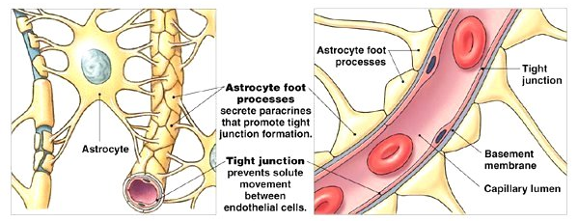
Pathogenesis
Brain is sterile & well protected
Skull
Blood brian barrier
Blood – CSF barrier (choroid plexus’s epithelial cells)
CNS disease influence by :
Host
Infecting organism
Diane EG, Pathogenesis of central nervous system infections. In : Pratibha S, Diane EG,Charles EN, editor. Central nervous system Infections in childhood. Mac Keith Press, London. 2014

Slide 23
Risk Factor
Hematogen
Sinusitis, mastoiditis, CSOM, AOM
Direct implantation
Open head injury
Neurosurgery procedure, lumbal puncture
Neonatus
Amnion fluid aspiration
Perkontinuitatum
Pneumonia, sepsis
Chavez-Bueno S, Mc Cracken JH. Pediatr Clin N Am 2005

Slide 24
Etiology
Age | Etiology
1 - 3 months | Group B streptococcus (39 %) gram-negative bacilli (E.Coli) (32 %) Streptococcus pneumoniae (14 %) Neisseria meningitidis (12 %)
3 months – 3 years | S. pneumoniae (45 %) N.meningitidis (34 %) group B streptococcus (11 %) gram-negative bacilli (E. Coli) (9 %)
3 – 10 years | S. pneumoniae (47 %) N.meningitidis (32 %)
10 – 18 years | N. meningitidis (55 %)
Thigpen MC, Whitney CG, Messonnier NE, et al. Bacterial meningitis in the United States, 1998-2007. N Engl J Med 2011; 364:2016.

Slide 25
Clinical manifestation
Initial presentation
Seizures, bulging fontanel, coma usually are seen later
In infants: fever, hypothermia, lethargy, respiratory distress, jaundice, poor feeding, vomiting, diarrhea, seizures, restlessness, irritability, and/or bulging fontanel
94%
Fever
82%
Vomiting
77%
Nuchal rigidity
Martin GT, Urs BS. Bacterial infection of the nervous system. In : Kenneth FS, Stephen A, Donna MF, Nina FS, editor. Swaiman’s pediatric neurology principles and practice. Elsevier. 2014.

Slide 26
Diagnostic evaluation
Complete blood count with differential and platelet count
Blood cultures (50 % positive)
Lumbal puncture is diagnosis of bacterial meningitis
CSF pleocytosis mononuclear (200-2000 cell/mm³)
CSF protein is 100-500 mg/dL
CSF glucose is decreased <40 mg/dL
Gram stain
CSF cultures
Martin GT, Urs BS. Bacterial infection of the nervous system. In : Kenneth FS, Stephen A, Donna MF, Nina FS, editor. Swaiman’s pediatric neurology principles and practice. Elsevier. 2014.

Slide 27
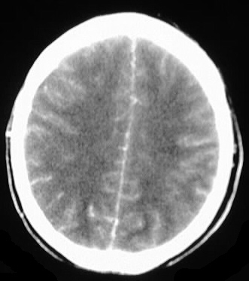
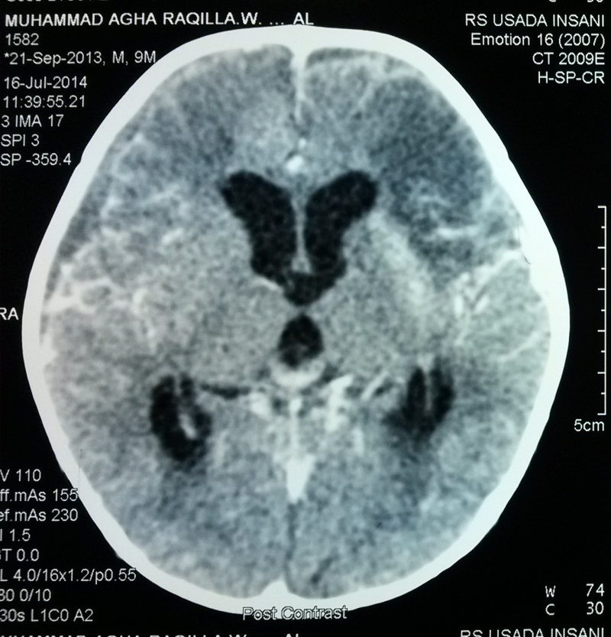
Diagnostic evaluation
Neuro imaging study
Meningeal enhancement

Slide 28
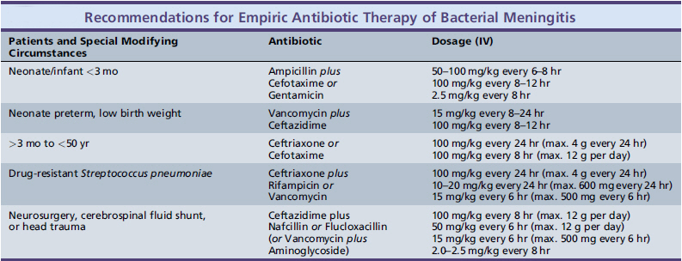
Treatment
Recommendation empiric antibiotic therapy based on case
Martin GT, Urs BS. Bacterial infection of the nervous system. In : Kenneth FS, Stephen A, Donna MF, Nina FS, editor. Swaiman’s pediatric neurology principles and practice. Elsevier. 2014.

Slide 29
Treatment
Empiric antibiotic therapy
Cefotaxime 300 mg/kg per day intravenously (IV) (maximum dose 12 g/day) in 3 or 4 divided doses
Ceftriaxone 100 mg/kg per day IV (maximum dose 4g/day) in 1 or 2 divided doses
Dexamethasone as prevention from sequalae
dexamethasone is given before or concurrently with the first dose of the antimicrobial agent
Dexamethasone 0.6 mg/kg per day divided to 4 dose for 2 to 4 days
Kim KS. Bacterial meningitis beyond the neonatal period. In: Feigin and Cherry’s Textbook of Pediatric Infectious Diseases, 7th, Cherry JD, Harrision GJ, Kaplan SL, et al. (Eds), Elsevier Saunders, Philadelphia 2014. p.425.

Slide 30
Treatment
Duration of antimicrobial therapy depends upon the causative organism and the clinical course.
S. pneumoniae – 10 to 14 days
N. meningitidis – 5 to 7 days
H. influenzae type b (Hib) – 7 to 10 days
L. monocytogenes – 14 to 21 days
S. aureus – at least 2 weeks
Gram-negative bacilli – 3 weeks or a minimum of 2 weeks beyond the first sterile CSF culture, whichever is longer
American Academy of Pediatrics. Haemophilus influenzae infections. In: Red Book: 2012 Report of the Committee on Infectious Diseases, 29th, Pickering LK. (Ed), American Academy of Pediatrics, Elk Grove Village, IL 2012. p.345.

Slide 31
Complication
Persistence of fever beyond eight days
Inadequate treatment
Development of nosocomial infection
Development of a suppurative complication (pericarditis, pneumonia, arthritis, subdural empyema)
Drug fever (a diagnosis of exclusion)

Slide 32
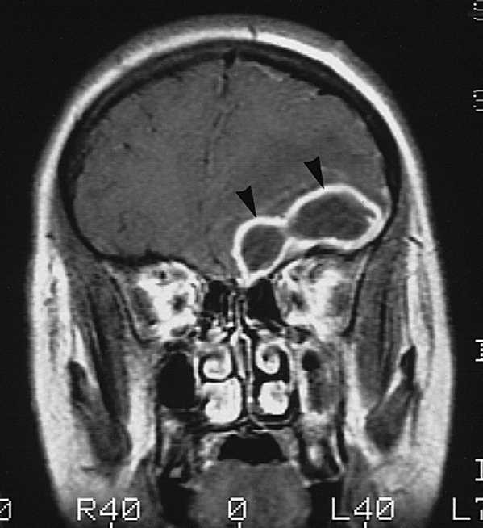
Complication
Cerebral Abscess

Slide 33
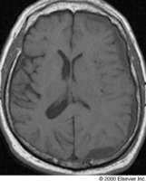
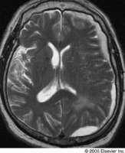
Subdural emphyema

Slide 34
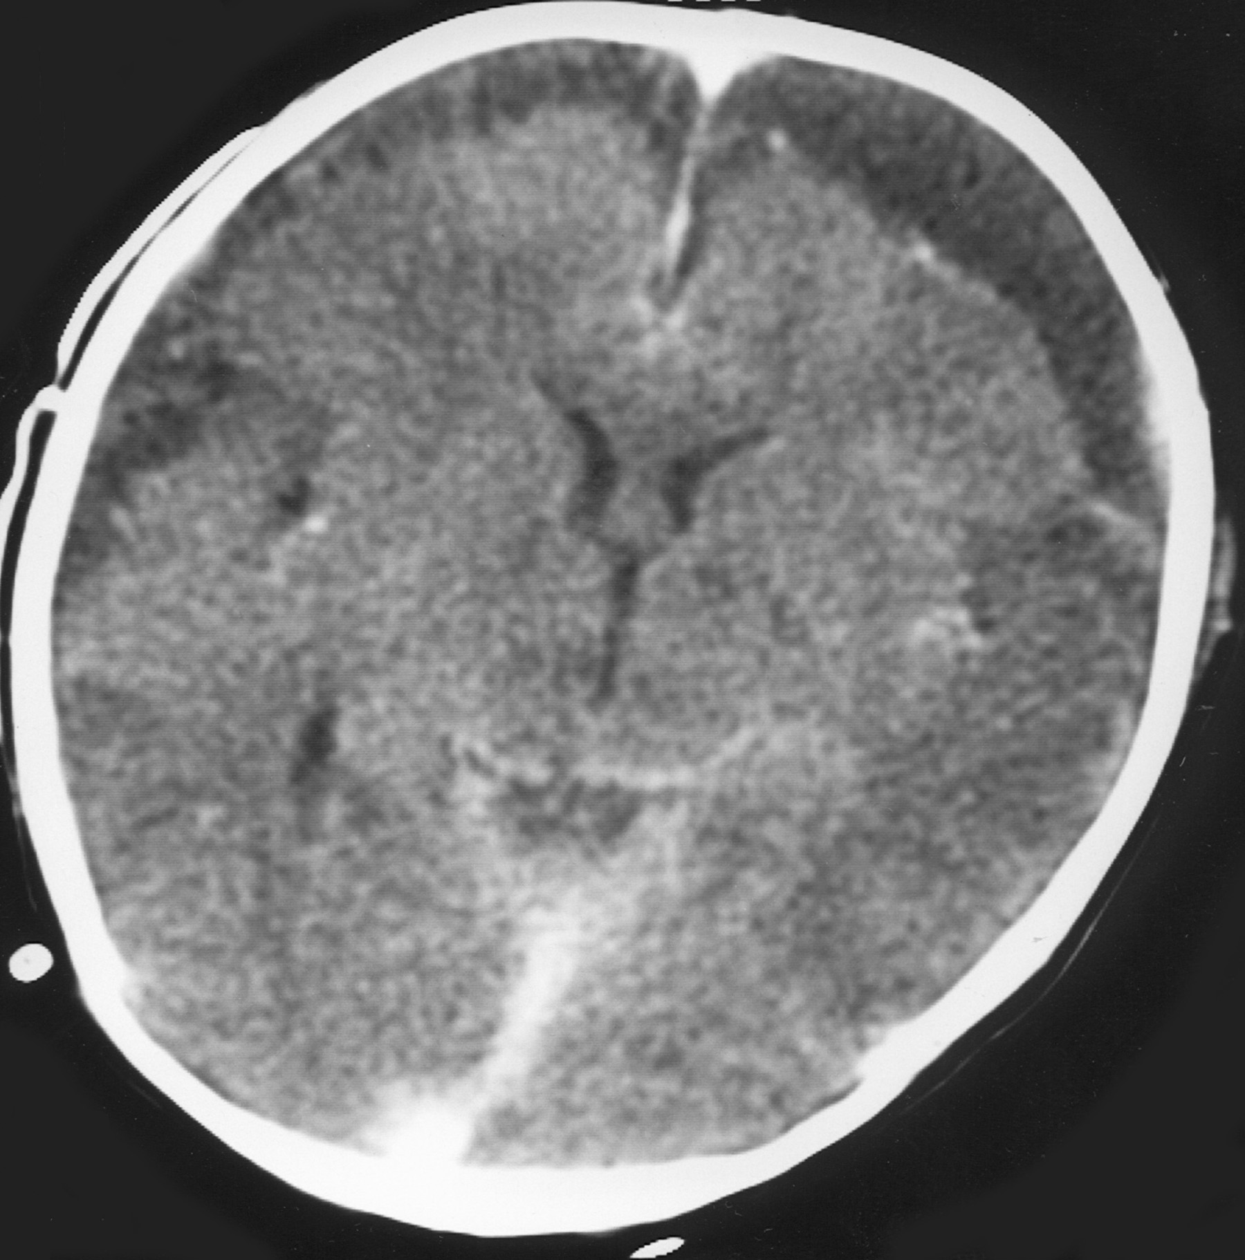
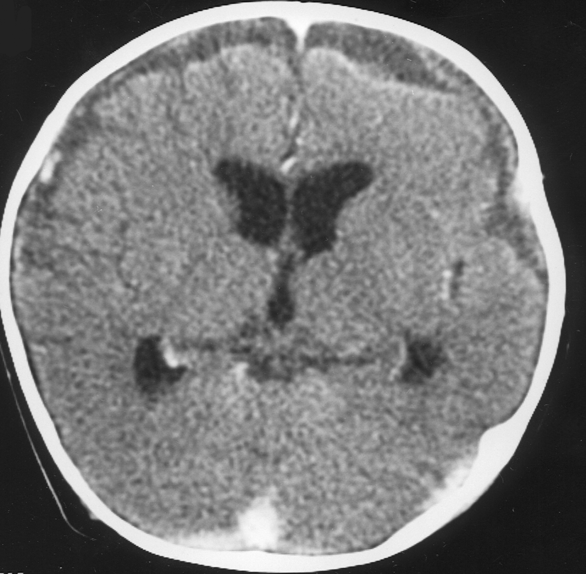
Subdural effusion

Slide 35
Tuberculous meningitis

Slide 36
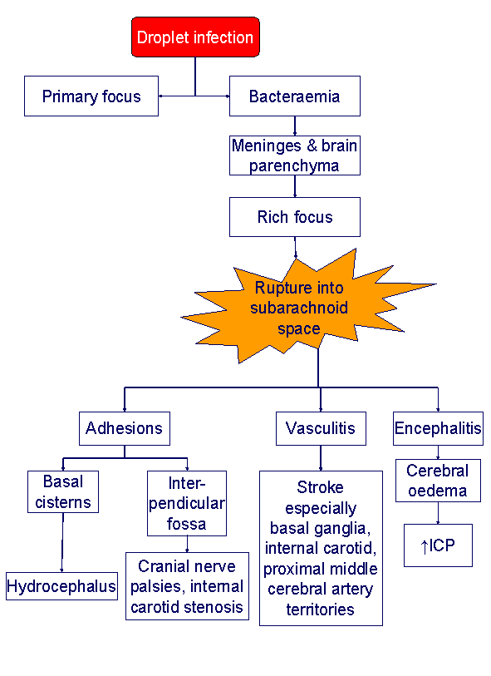
Pathogenesis
http://aic-server4.aic.cuhk.edu.hk/web8/TB-meningitis.htm

Slide 37
Clinical manifestation
Stage 1 : prodormal (2-3 weeks)
Young infants : fever, cough, altered consciousness, bulging anterior fontanel, and generalized tonic-clonic seizures.
Older children : malaise, lassitude, headache, low-grade fever, and personality change. No nuchal rigidity.
Martin GT, Urs BS. Bacterial infection of the nervous system. In : Kenneth FS, Stephen A, Donna MF, Nina FS, editor. Swaiman’s pediatric neurology principles and practice. Elsevier. 2014.

Slide 38
Clinical manifestation
Stage 2 : transition / meningitis. Meningismus, protracted headache, vomiting, lethargy, confusion, and varying degrees of cranial nerve and long-tract signs
Stage 3 : terminal. depression of consciousness (stupor, coma), convulsions, possibly papilledema, and major neurologic deficits
Martin GT, Urs BS. Bacterial infection of the nervous system. In : Kenneth FS, Stephen A, Donna MF, Nina FS, editor. Swaiman’s pediatric neurology principles and practice. Elsevier. 2014.

Slide 39
Diagnostic evaluation
Mantoux test
Chest X-Ray
Lumbal puncture is critical importance to early diagnosis of TB meningitis
CSF pleocytosis mononuclear (10-500)
CSF protein is 100-3000 mg/dL
CSF glucose is <45 mg/dL (80 %)
Martin GT, Urs BS. Bacterial infection of the nervous system. In : Kenneth FS, Stephen A, Donna MF, Nina FS, editor. Swaiman’s pediatric neurology principles and practice. Elsevier. 2014.

Slide 40
Diagnostic evaluation
Neuro imaging study
CT scan. In two large community-based series :
hydrocephalus (75%)
basilar meningeal enhancement (38 %)
cerebral infarcts (15-30 %)
tuberculomas (5-10 %)
MRI is superior to CT in defining lesions of the basal ganglia, midbrain, and brainstem and for evaluating all forms of suspected spinal TB
Bhargava S, Gupta AK, Tandon PN. Tuberculous meningitis--a CT study. Br J Radiol 1982; 55:189.
Ozateş M, Kemaloglu S, Gürkan F, et al. CT of the brain in tuberculous meningitis. A review of 289 patients. Acta Radiol 2000; 41:13.

Slide 41
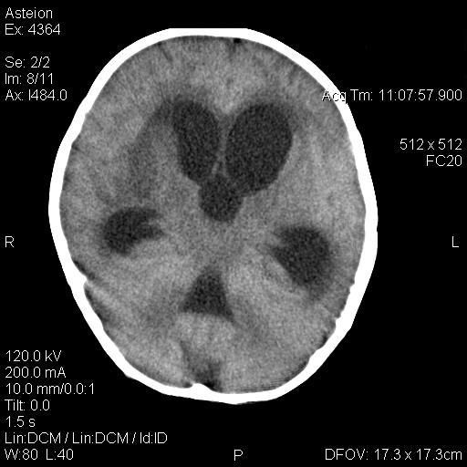
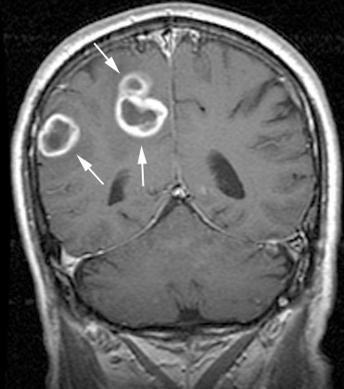
tuberculomas
hydrcephalus
tuberculomas
Martin GT, Urs BS. Bacterial infection of the nervous system. In : Kenneth FS, Stephen A, Donna MF, Nina FS, editor. Swaiman’s pediatric neurology principles and practice. Elsevier. 2014.

Slide 42
Treatment
Antituberculous chemotherapy initial two month period with four drugs, followed by INH and Rifampicin for 10 months (Grade 1B)
INH 10 mg/kg per day (max 300 mg)
Rifampicin 10-15 mg/kg per day (max 600 mg)
Pyrazinamide 15 to 30 mg/kg per day (maximum 2 g)
Ethambutol 15 to 25 mg/kg per day
Streptomycin 20 to 40 mg/kg per day
Chemotherapy and management of tuberculosis in the United Kingdom: recommendations 1998. Joint Tuberculosis Committee of the British Thoracic Society. Thorax 1998; 53:536.

Slide 43
Treatment
Adjunctive glucocorticoid therapy (Grade 1A)
Dexamethasone 0.5-0.6 mg/kg/day for children for three weeks, then tapered off gradually over the following three to four weeks.
Prednisone – A dose of 2 to 4 mg/kg per day for three weeks, then tapered off gradually over the following three weeks.
Shunting is treatment for hydrocephalus
Treat seizures as soon as possible
Treat increased intracranial pressure
Children with severe tuberculous meningitis should be hospitalized in ICU
American Academy of Pediatrics. Herpes simplex. In: Red Book: 2012 Report of the Committee on Infectious Diseases, 29th, Pickering LK. (Ed), American Academy of Pediatrics, Elk Grove Village, IL 2012. p.398.

Slide 44
Complication
status epilepticus
cerebral edema
inappropriate secretion of antidiuretic hormone
cardiorespiratory failure
hydrocephalus
Bronstein DE, Shields WD, Glaser CA. Encephalitis and meningoencephalitis. In: Feigin and Cherry’s Textbook of Pediatric Infectious Diseases, 7th, Cherry JD, Harrison GJ, Kaplan SL, et al. (Eds), Elsevier Saunders, Philadelphia 2014. p.492.

Slide 45
Lumbar Puncture interpretation
CNS Infection | White blood cell count (cell/mm³) | Protein (mg/dL) | Glucose (mg/dL)
normal | Neonates usually up to 5 (20-30) Children : 0-5 | Neonates up to 120 falls by 3 months Children : 10-40 | >50 (or 60% blood glucose)
Bacterial meningitis | Elevated 200-2000 PMN (100-10.000) | 100-500 | Decreased <40 (or <50% blood glucose)
Partially treated bacterial meningitis | Normal to elevated (5-10.000 PMN) | 100-500 | Normal or decreased
Viral encephalitis | 10-500 MN | 50-200 | normal
Tuberculous meningitis | Normal to elevated 10-500 (PMN early than MN) | 100-3000 | <50
Martin GT, Urs BS. Bacterial infection of the nervous system. In : Kenneth FS, Stephen A, Donna MF, Nina FS, editor. Swaiman’s pediatric neurology principles and practice. Elsevier. 2014.

Slide 46
Conclusion
CNS infections are an emergency case in child neurology. It can cause cause death or impairments
Lumbal puncture is a safe procedure to make a diagnosis of CNS infection
Neuroimaging can sometimes rule out differential diagnosis and find complication of CNS infection
Treatment based on etiology. Delayed on treatment significantly related to poor prognosis

Slide 47
THANK YOU

